Slide 1
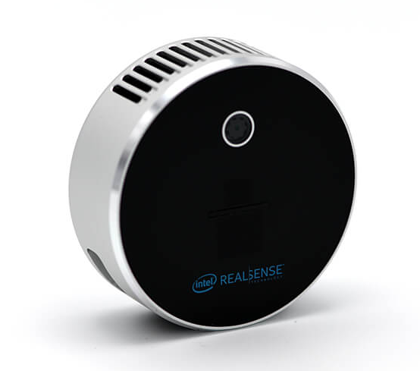
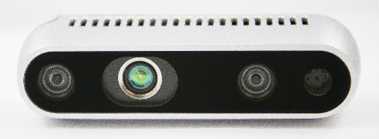
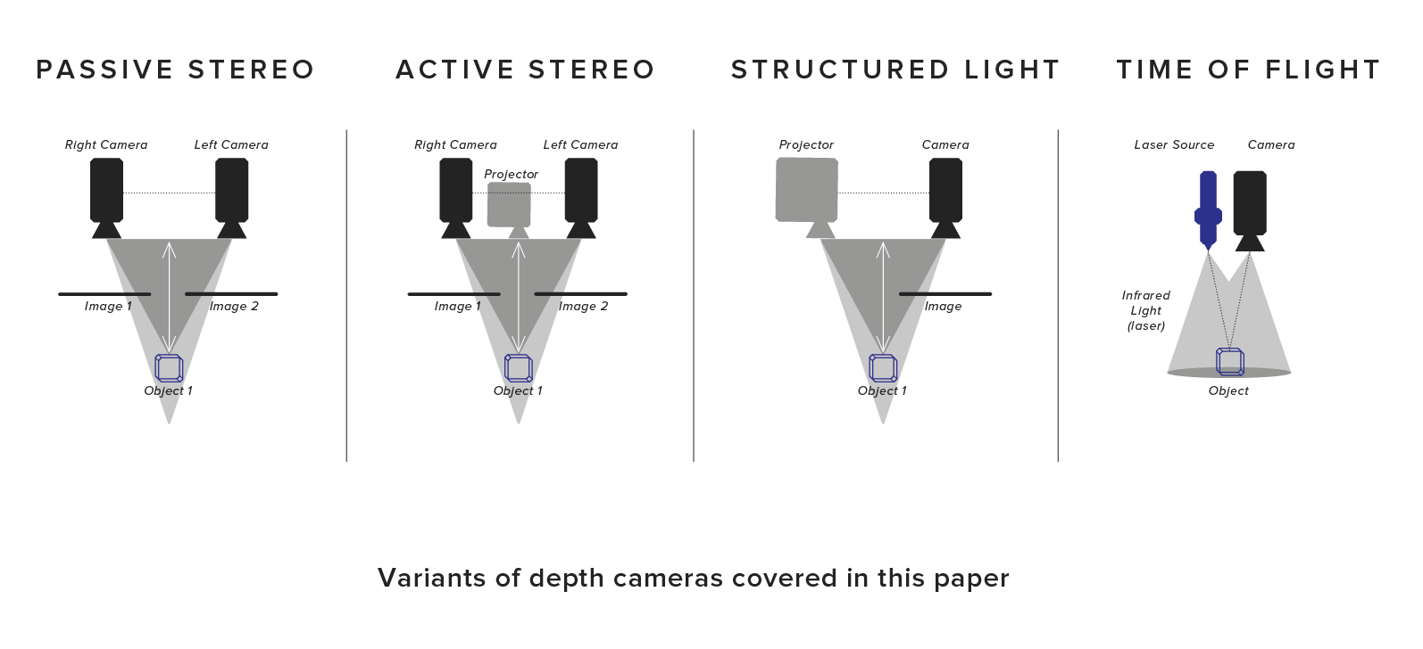
Ⅰ. LiDAR 카메라
D435, D435i
L515
Depth Technology : Active Stereo
Depth Technology : ToF

Slide 2

Ⅱ. 현 추종 모드 문제점
Issue 1 During the Mobile robot follow User, Obstacleor Person enter into obstacle zone.
Issue 2 During the Mobile robot follow User, Tracked Person is close to wall.
Issue 3 During the Mobile robot follow User, Tracked Person is out of Tracking Range.

Slide 3
Ⅱ. 현 추종 모드 문제점
userArrayCallback(const mpc_follow_mode::TrackerUserArrayConstPtr &ptr)
if (skip_detection > 10) {
mc->clearVelocity();
mc->publishVelocity();
run =3;
}
Because there is no delay function, skip detection is fast increase.
Issue 3 During the Mobile robot follow User, Tracked Person is out of Tracking Range.

Slide 4
Ⅱ. 현 추종 모드 문제점
obstacleCallback(const mpc_follow_mode::ObstacleConstPtr &ptr)
if ((scanner_z != 0.0 && scanner_z < OBSTACLE_MAX_Z) || (point_z != 0.0 && point_z < OBSTACLE_MAX_Z)
) {
if(detect == 1){
near_user = true;
mc->clearVelocity();
mc->publishVelocity();
run = 3;
}
}
else
{
if (run == 1 && detect == 1)
{
run = 3;
near_user = true;
mc->clearVelocity();
mc->publishVelocity();
}
}
Issue 1 During the Mobile robot follow User, Obstacle or Person enter into obstacle zone.

Slide 5
Ⅲ. 현 추종 모드 동작 과정
인식요청
N
Intersection over Union
Calculation linear & angular speed
Laser Scanner Data scan
작업자 인식 여부
Y
Predict location & correction using Kalman Filter
Adaptive Speed Control
Constant Speed Control
추적 객체 중심 Object 제거
N
Morphology 연산
Tracking Person
추적 객체 중심 Scan 영역 제한
N
Move Control
Labeling
작업자 추적 여부
Person recognition
Object distance area
Y
작업자 위치 추정
Person tracking
Object 인식 여부
Y
Move control
Object Publish

Slide 6
Ⅲ. 현 추종 모드 동작 과정
Union area = current_area + predict_area – overlapping_area
max_y
c_y
overlapping area
min_y
iou =
union area
max_x
min_x
c_x
scanCallback(const sensor_msgs::LaserScan::ConstPtr& scan);
userArrayCallback(const mpc_follow_mode::TrackerUserArrrayConstPtr &ptr);
Polar() -> Cartesian();
overlapping_area();
Obstacle_Zone & Tracker Zone
intersection_over_union();
limitDetectArea();
predict_kalman_filter();
removeObject();
detectMorpology();
detectCreatelabel();
detectCalculationDistace();

Slide 7

Ⅲ. 현 추종 모드 동작 과정
PERSON_NEAR
x
MIN_DISTANCE
MAX_DISTANCE
y
PERSON_NEAR
PERSON_IN_ZONE
PERSON_FAR
PERSON_IN_ZONE
Follow Mode
Drive Mode
PERSON_FAR
gain_p
gain_p_angle
gain_d
gain_d_angle
Distance : scanner_object.y
Direction : err_p_angle, err_d_angle
cmd->linear.x
cmd->angular.z
Point3D userCoordinate.getAngleFromOrigin() * (3.14159 / 180)
MoveControl::moveScanner(int userId, std:;string scanner, ::geometry_msgs::Vector3 scanner_object);
mc->moveScanner(trackerUser.tracker_id, frame_id, trackerUser.center_of_mass);
scannerCalculateVelocity(userId, scanner, scanner_object);
publishVelocity();

Slide 8
Ⅳ. LiDAR 카메라 연동 방안
Camera
LRF
Network
Direction : θc
Distance : Dc
Direction : θl
Distance : Dl
Detection data
Camera Weight : Cw
LRF Weight : Lw
Jetson Nano
SPEAR-MX8
Environment State
Target Detection
Motion Control
(Sensor Data Fusing)
LRF
Sensor Fusion
Command
Image data
Wheel
Tracking Info
Camera
Tracking Direction : θ
Tracking Distance : D
Vision & LRF based Tracking System Configuration
Environmental Adaptive Sensor Fusion Model

Slide 9


Ⅳ. LiDAR 카메라 연동 방안
Detection Algorithms
HAAR
HOG(Histogram of Oriented Gradients)
YOLO(You Only Look Once)
Person detection
SSD(Single Shot Multibox Detector)
cv::CascadeClassifier
load(const String &filename)
detectMultiScale(InputArray image, std::vector<Rect> &objects, std::vector<int> &numDetections,
double scaleFactor = 1.1, int minNeighbors = 3, int flags = 0, Size minSize = Size(),
Size maxSize = Size())
Point(x1, y1)
detectMultiScale()
rectangle()
Point(x2, y2)
Input image
Return detected Object Rectangle Point
Draw Rectangle based Point in input image

Slide 10
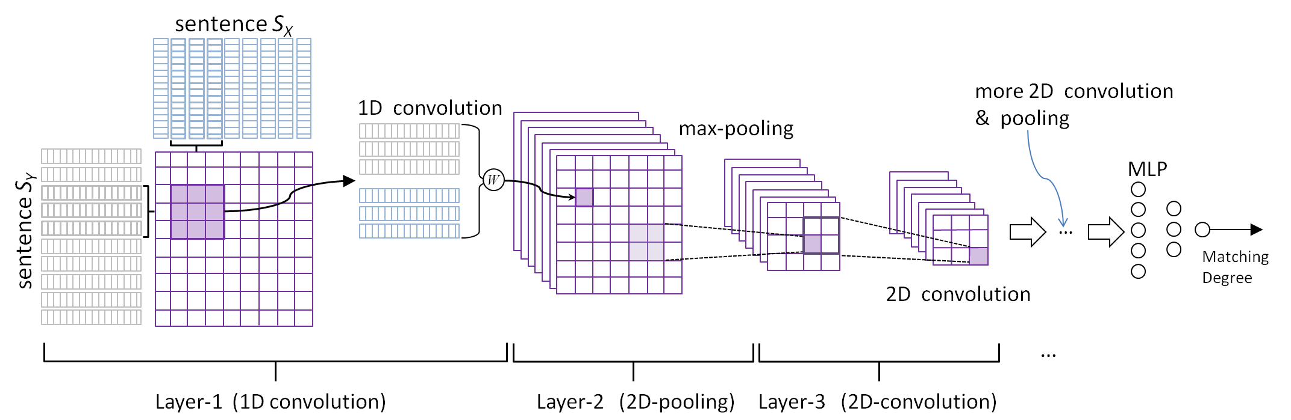
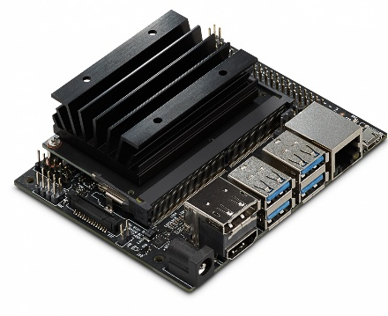
Ⅳ. LiDAR 카메라 연동 방안
Input Image
Person Detect
Framework : TensorFlow
OpenCV 4.1.1
CNN Model : SSD Mobilenet –V2
JetPack 4.2.2
FPS : ?
L4T
mAP : ?
Require DC 5V 4A Power Adapter to execute heavy program. (YOLO)

Slide 11

Ⅳ. LiDAR 카메라 연동 방안
RGB Image
Tracking Person Info
Person detection
Calculate detection Coordinate
Measure Distance
Command Velocity (Linear & Angular)
Person detection : If frame is increased, very slow fps. So, Video Frame is recommended Size(200, 200) to run similarly to real-time.
 | Y | N
fps | 1 ~ 2 fps | 10 ~ 19 fps
To Increase FPS,
1. PC Spec UP
2. Change Detection Function Parameter
Above the table shows the number fps which uses the detectMultiScale function. The Frame Size if 640 x 480 pixel.
3. Change Detection Algorithm

Slide 12
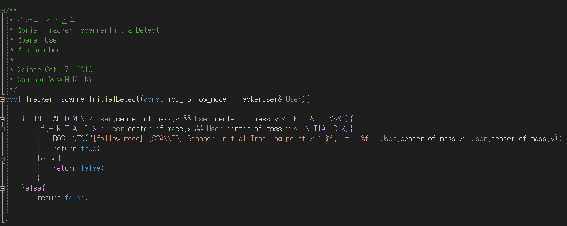
class DisplayFollowInfo()
{
void display_start_info();
void display_stop_info();
void display_follow_drive_info(int cmd, int detect_user, int detect_obstacle);
void display_skip_detection();
void display_clear();
}
void display_start_info();

Slide 13
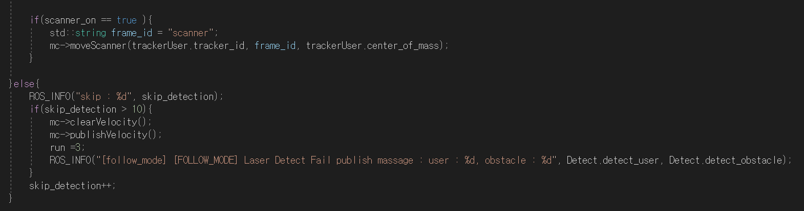
class DisplayFollowInfo()
{
void display_start_info();
void display_stop_info();
void display_follow_drive_info(int cmd, int detect_user, int detect_obstacle);
void display_skip_detection();
void display_clear();
}
void display_follow_drive_info(cmd, detect_user, detect_obstacle);
void display_stop_info();
void display_skip_detection();

Slide 14
Ⅱ. 현 추종 모드 문제점 해결 전략
Boundary Box
Detection Zone
Total Frame
Detection (Method 2)
Issue 1
Issue 2
Issue 3
Make Tracker initial box
Update Tracking box (GOTURN)
Solution 1
Solution 2
Solution 3
Extract tracker_id, position Info

Slide 15
Ⅱ. 현 추종 모드 문제점 해결 전략
Tracker | Speed | Accuracy | Redetection
Boosting | Low | Low | X
MIL |  |  | X
KCF | Low | High | O
TLD |  |  | X
MEDIANFLOW |  |  | X
GOTURN | Normal | High | O
MOSSE | Fast | Low | X
CSTR | Low | High | X
Method 1
Total Frame
Detection Zone
Method 2
Detection Zone
Detection Zone
Tracker::init(frame, box)
Tracker::update(frame, box)

Slide 16
Ⅱ. 현 추종 모드 문제점 해결 전략
Method 1
Original Method
Intersection Position value
Method 2
Rectengle (width / 2, height / 2)
Average N-Point Position value

Slide 17

Ⅱ. 현 추종 모드 문제점 해결 전략
Distance_C
Distance_L
$$Distance_{total}= \frac{Distance_{c}+Distance_{l}}{2}$$
$$if (Distance_{total}<Min_{distace} \&\& Distance_{c}<Min_{distance} \&\& Distance_{l}<Min_{distance})$$
Issue 1
Solution 1
$$else if (Distance_{total}<Min_{distace} \&\& Distance_{c}>Min_{distance} \&\& Distance_{l}<Min_{distance})$$

Slide 18







Ⅱ. 현 추종 모드 문제점 해결 전략
$$er{r_{p}}_{angle}=Point3D.getAngleFromOrigin ∗\frac{3.14159}{180}$$
$$er{r_{d}}_{angle}=er{r_{p}}_{angle} −prev_{angle}$$
$$gai{n_{p}}_{angle}, gai{n_{d}}_{angle}↔Distance$$
?
$$ang_{c}=point\left(x\right) −point(\frac{width}{2})$$
Issue 2
$$ang_{z}=\left(gain_{p_{angle}}∗err_{p_{angle}}+gain_{d_{angle}}∗err_{d_{angle}}\right)$$
Solution 2
$$−Angular_vel_Max$$
$$ang_{z}$$
$$Angular_vel_Max$$

Slide 19
Ⅱ. 현 추종 모드 문제점 해결 전략
Tracking Person Missing?
Increase Detection Range
Stop
Not Yet Detection?
Skip_detection ++
Following Person
Restart
Issue 3
Not Yet Detection?
Solution 3

Slide 20
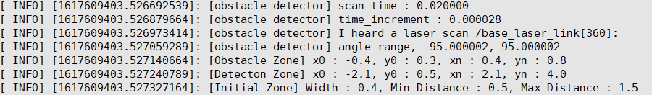





Ⅱ. 기존 스캐너 데이터 관측 및 문제점
scan_time : time between scans [seconds]
time_increment : time between measurements [seconds]
$$count= \frac{scan time}{time increment}$$
$$scan_{time} :0.02 [s]$$
$$unit degree:0.52777°$$
1.0
$$time increment :0.000028 \left[s\right]$$
$$count :360$$
0.667
$$−95°$$
$$95°$$
0.5
0.3333
0.25
0.1667

Slide 21

Ⅱ. 기존 스캐너 데이터 관측 및 문제점
$$obstacle\max{distance}: 0.8 \left[m\right]$$
$$detect\max{distance }:4.0 \left[m\right]$$
$$obstacle width :− 0.4 \left[m\right]$$
$$obstacle width : 0.4 \left[m\right]$$
$$detect width :−2.1 \left[m\right]$$
$$detect width :2.1 \left[m\right]$$
$$obstacle\min{distance}: 0.3 \left[m\right]$$
$$detect\min{distance }:0.8 \left[m\right]$$

Slide 22
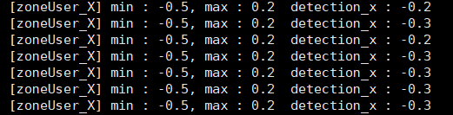


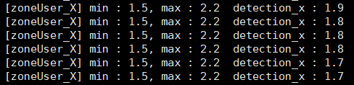
Ⅱ. 기존 스캐너 데이터 관측 및 문제점
zone_user.min_point.x
zone_user.max_point.x

Slide 23
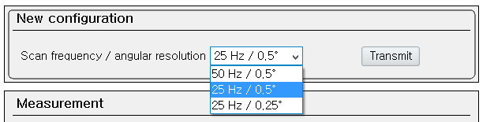
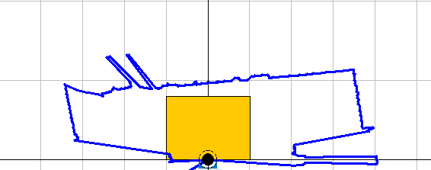
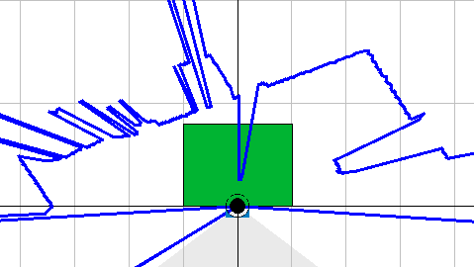
Ⅱ. 기존 스캐너 데이터 관측 및 문제점
1. SOPAS Parameter
$$zone\max{distance }:2.6 \left[m\right]$$
$$zone width :−0.5 \left[m\right]$$
$$zone width :1.5 \left[m\right]$$
$$zone\min{distance }:0.3 \left[m\right]$$
2. SICK -> Hokuyo
3. Tracker.cpp

Slide 24
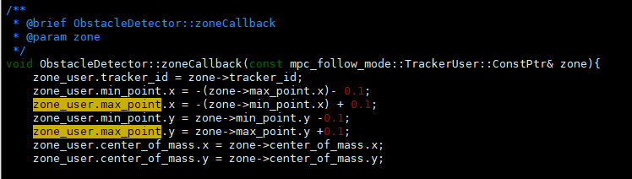
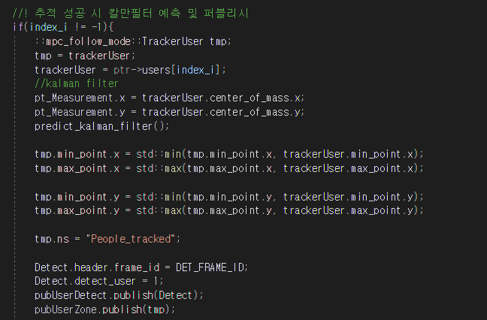
Ⅱ. 기존 스캐너 데이터 관측 및 문제점
3. Tracker.cpp
zoneCallback
userArrayCallback

Slide 25
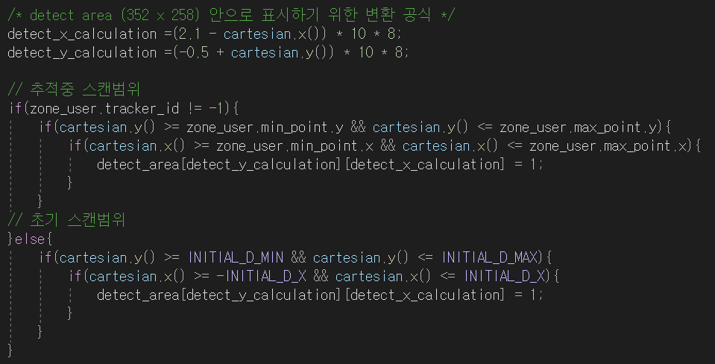
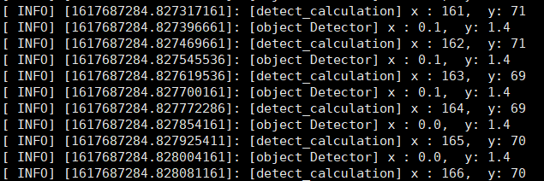
Ⅱ. 기존 스캐너 데이터 관측 및 문제점
0 | 0 | 0 | 0 | 0
0 | 0 | 0 | 0 | 0
0 | 0 | 0 | 0 | 0
0 | 0 | 0 | 0 | 0
0 | 0 | 0 | 0 | 0
0 | 0 | 0 | 0 | 0
0 | 0 | 0 | 0 | 0
0 | 1 | 0 | 0 | 0
0 | 1 | 0 | 0 | 0
0 | 1 | 1 | 1 | 0
0 | 0 | 1 | 1 | 0
0 | 0 | 0 | 0 | 0

